Slide 1
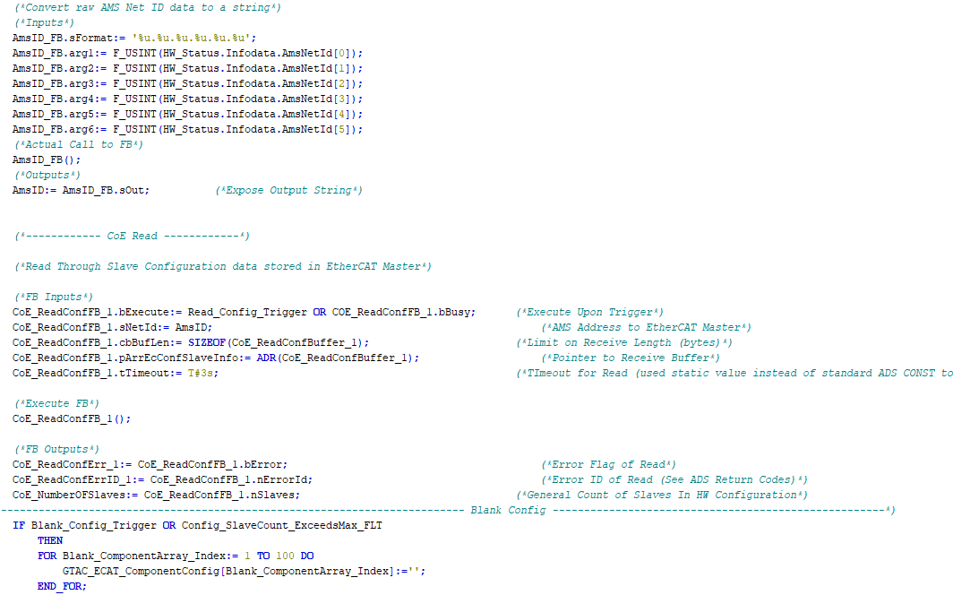

Internal Training:
TcHmi & Database (DB)

Slide 2
Prerequisites
If you’re in this training session it means you have the following under your belt:
Setup of your local PC environment as per the IC Setup Guide contained in the SSCC610 machine package with:
XAE 4024.55 (in addition to .22)
TcHmi TE2000 (TcHmi Engineering)
TcHmi TF2000 (TcHmi Server)
Postgres / pgAdmin (Database / Database administrative tool)
Successfully deployed FW level SSCC610 locally on the above environment
TR7050 Beckhoff based training: Basics TwinCAT HMI
Base GTAC Internal TcHmi and SSCC610 Training

Slide 3

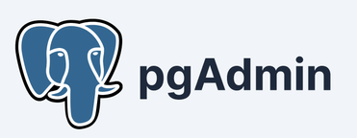
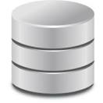

General Topology
Postgres
Database
Server
pgAdmin is an
administrative tool
Used to configure the
Postgres Database
Our TcHmi Project (with our PostgreSQL Server Extension)
Administrative
Commands
Bi-Directional
Data

Slide 4
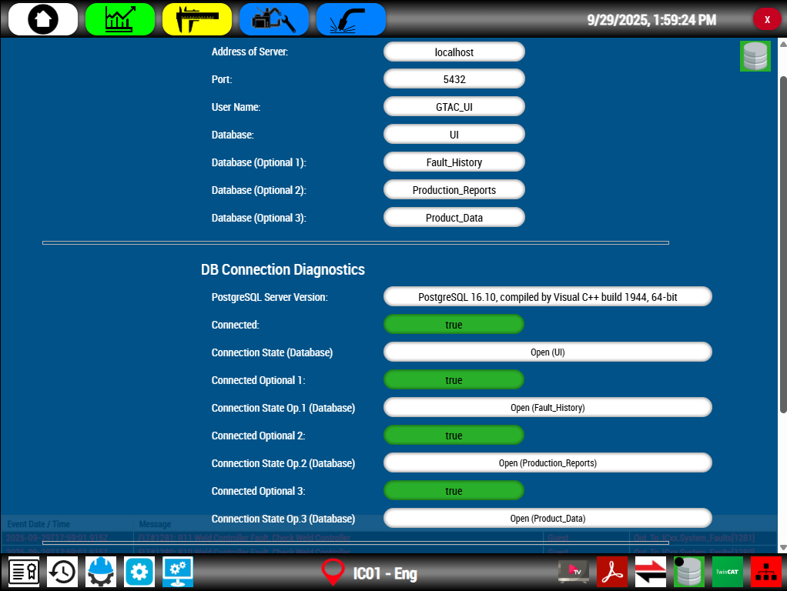
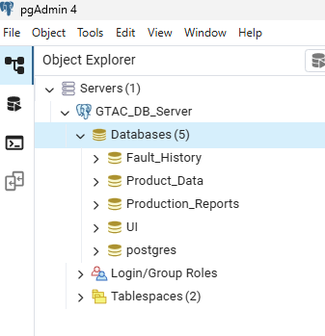
General Topology
Out of the box, our FW uses a total of four databases in the PostgreSQL server. Each DB contains their own tables for data organization, storage and retrieval. The status of connection between Tchmi and the server / databases can be seen on our database screen.

Slide 5
Data Flow
The general direction of data flow depends on what database TcHmi is interacting with. Below is a general diagram indicating data flow. In the next slides we will explore the use of each database.

Slide 6
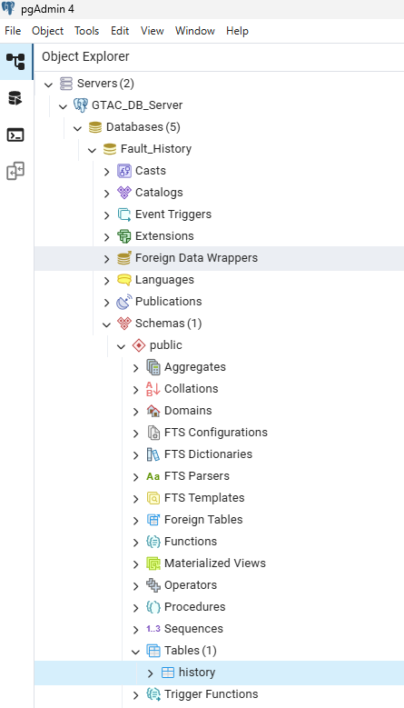
Fault_History Database
The Fault_History Database contains one table called history.
This table is the location where all fault events that occur on the machine are saved as records.
Later, if the fault history screen is opened on the UI we read the records from this table, the data is then displayed on the UI screen.

Slide 7


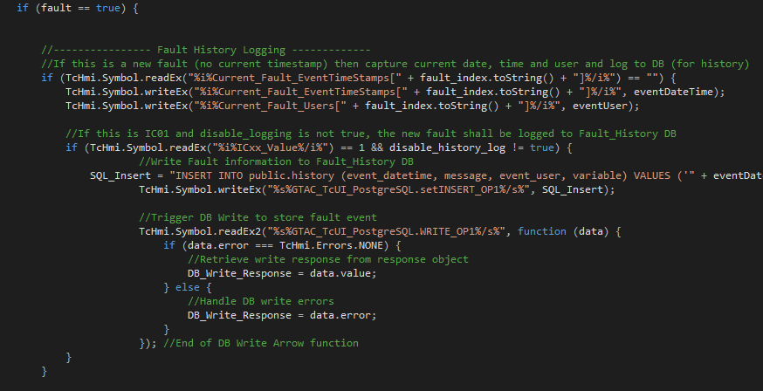
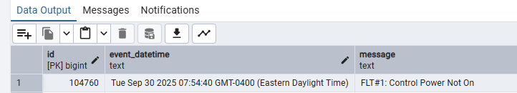
Fault_History Database
When a machine fault occurs, the GTAC_FaultHandler.js script in TcHmi detects this event and stores the fault information as a record in the history table of the Fault_History Database.

Slide 8
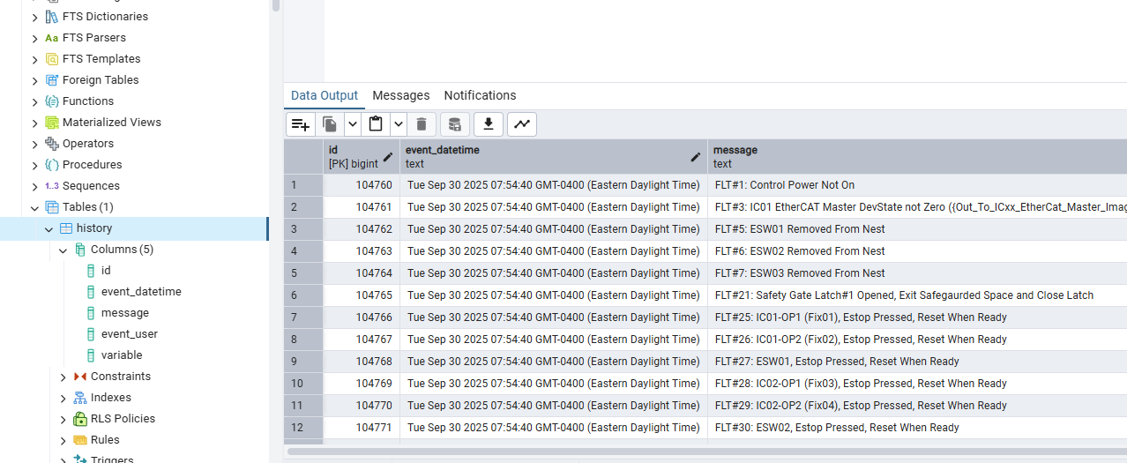
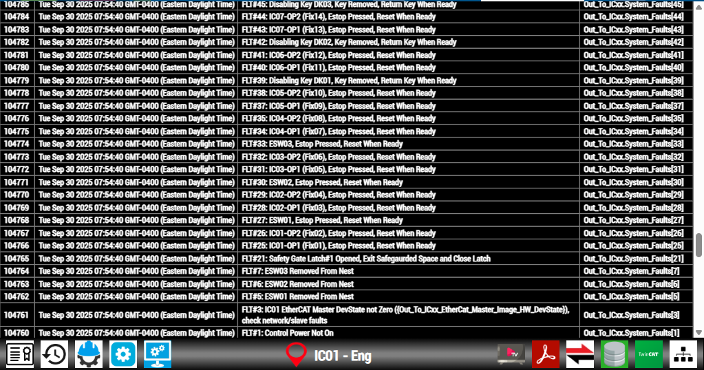
Fault_History Database
If the Fault History Page is loaded, the last 500 (configurable) fault records are read from the history Database table and displayed on the UI.

Slide 9
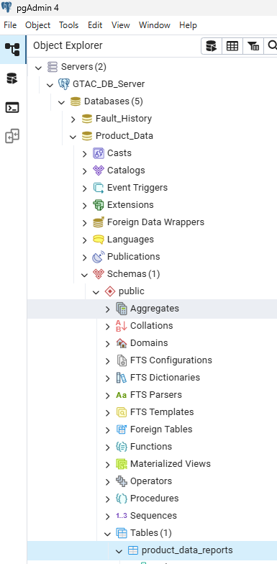
Product_Data
Database
The Product_Data Database is an area we can use to store serialized data as each part comes off the line. It contains one table called product_data_reports which we will breakdown in the next slide.

Slide 10
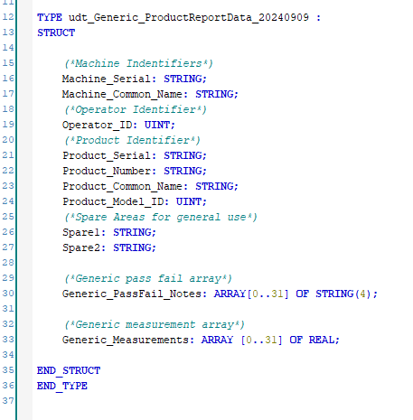
Product_Data
Database
The product_data_reports table contains columns as per below, these coincide with the general data structure in the PLC for the same purpose.

Slide 11
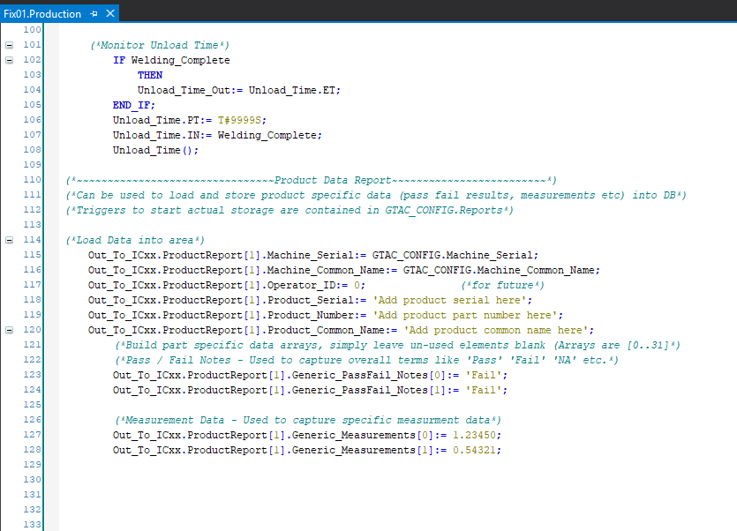
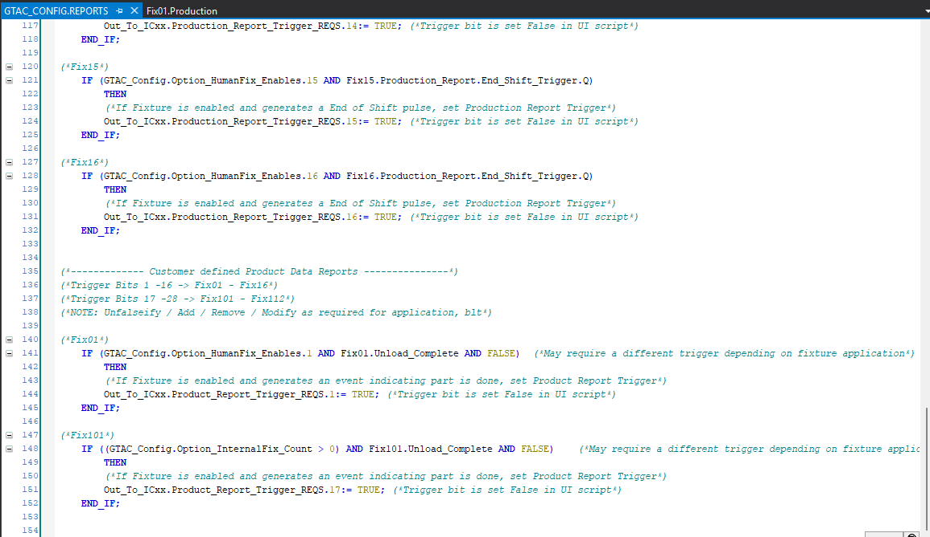
Product_Data
Database
In the PLC, there is a product data area built into each Fixture POU. Loading the data, as required by the application, into the area is done in the fixture production action. Below is the template provided in the FW. Customize as required!
The triggers to store the product data reports into the DB are done in the Reports action of the GTAC_Config POU. Again, templates are provided as example in the FW, customize as needed. Once a trigger is generated, TcHmi grabs the data area associated with the trigger and Inserts the appropriate report into the product_data_report table.

Slide 12
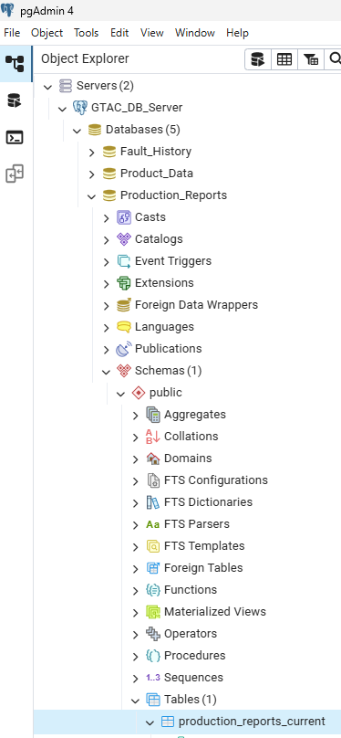
Production_Report
Database
The Production_Report Database contains one table called production_reports_current.
This table’s layout should look very familiar to any of you familiar with the production reporting we used to do in IWS.

Slide 13
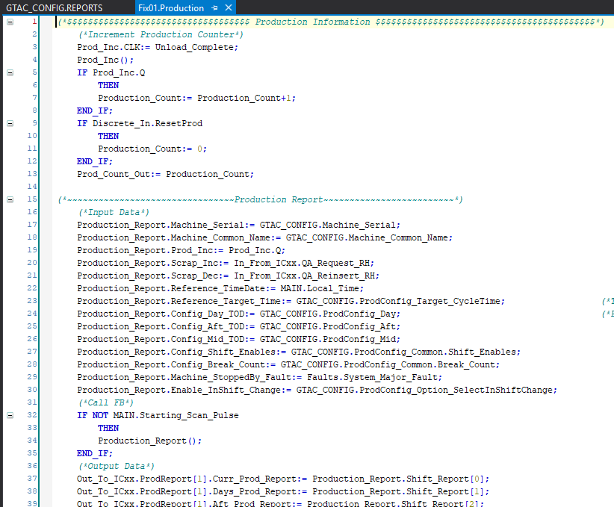
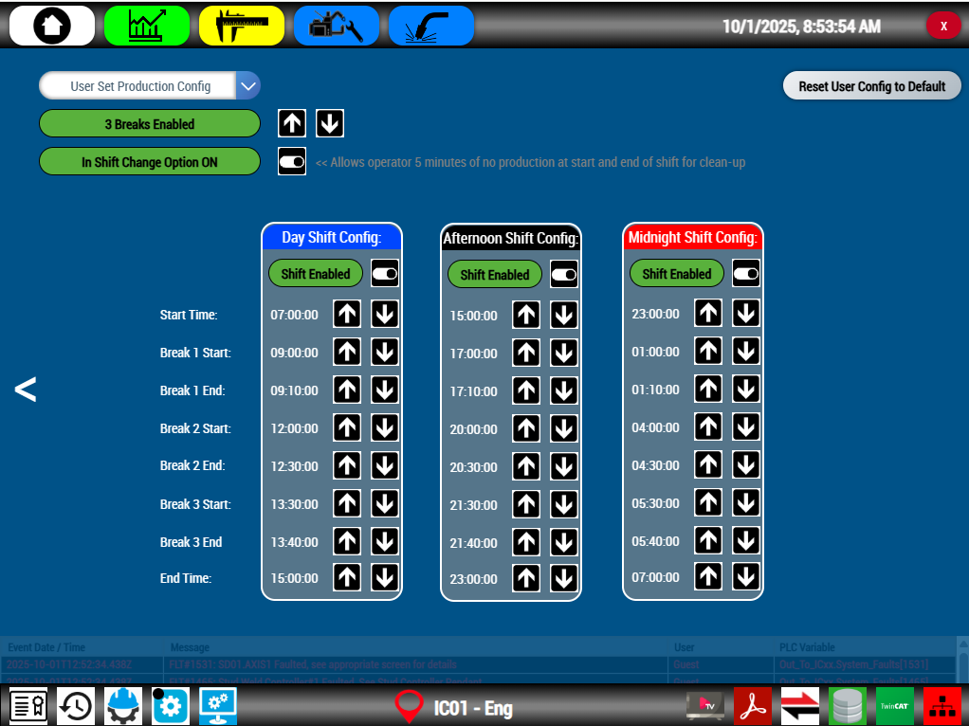
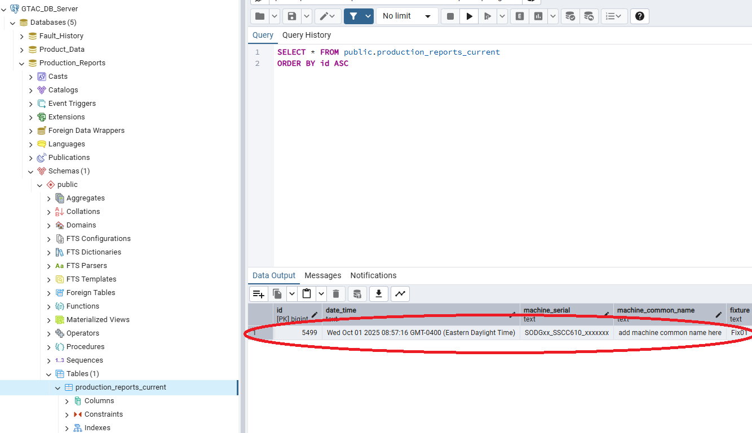
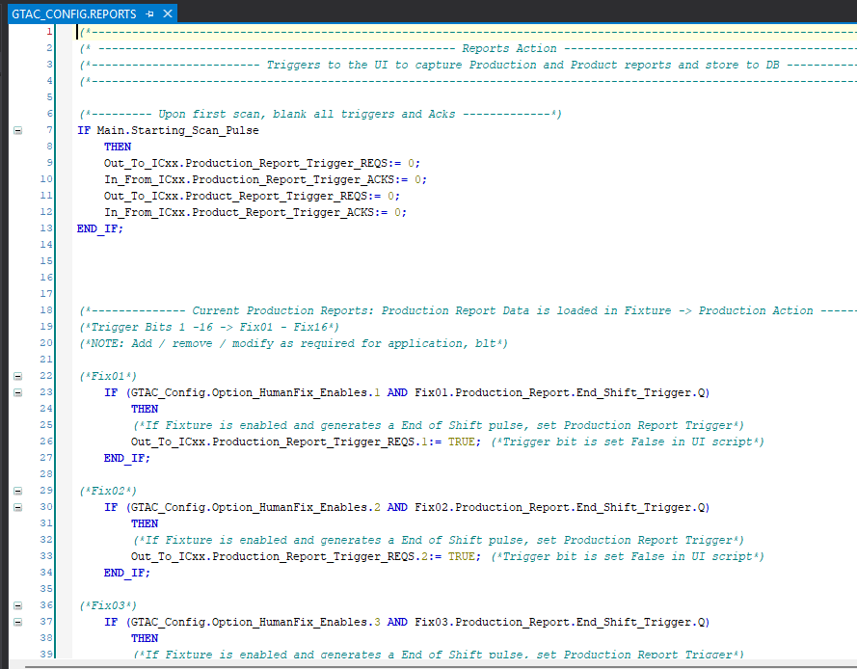
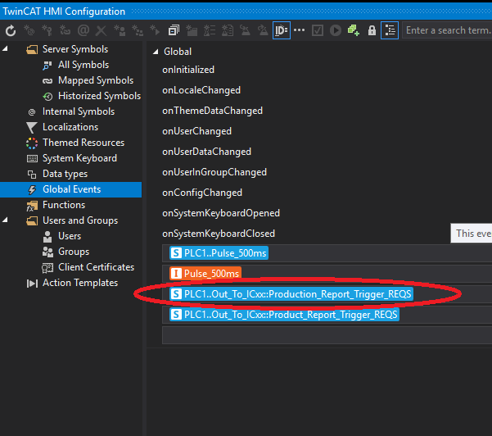
Production_Report
Database
The code, both PLC and in TcHmi, for the production reports comes complete right out of the box in the FW. At the end of the configured shift(s), a trigger is generated, this sends a signal to TcHmi to capture the Production Report Data area of the fixture(s) which generated the trigger and Insert the report data into the production_reports_current table.

Slide 14
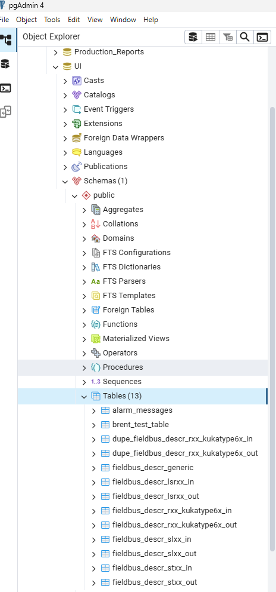
UI Database
The UI Database contains tables which we read from to assemble the text portions of the following:
Alarm Messages
LSRxx Fieldbus In / Out Descriptions
Rxx Fieldbus In / Out Descriptions
SLxx Fieldbus In / Out Descriptions
STxx Fieldbus In / Out Descriptions
In some cases (Alarms and Rxx to date) we store multi language versions of each message / description.

Slide 15
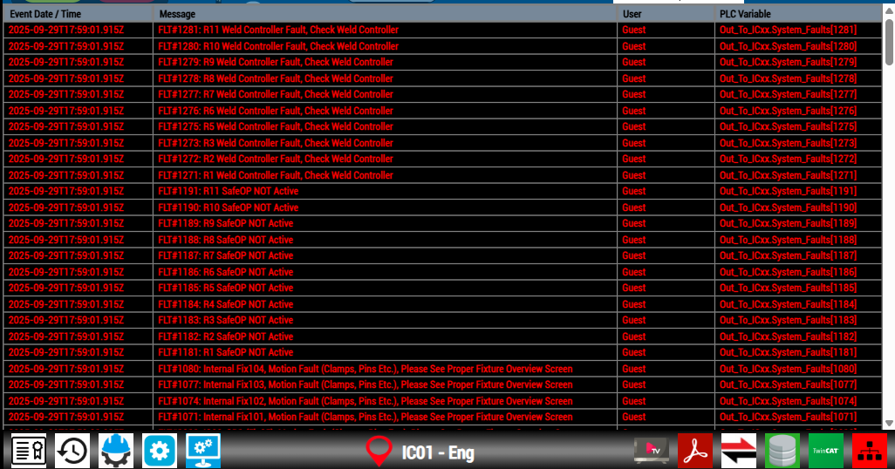
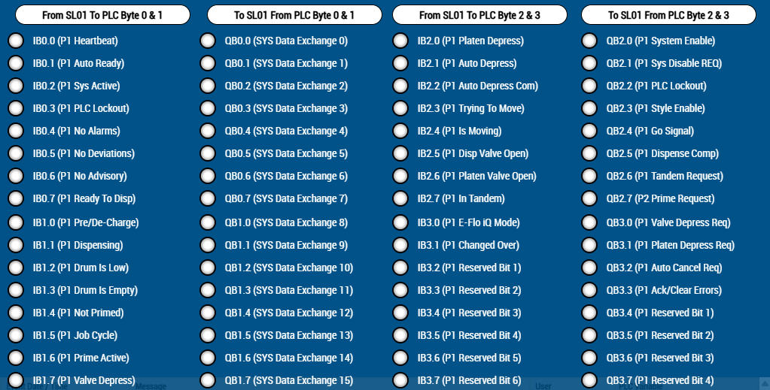
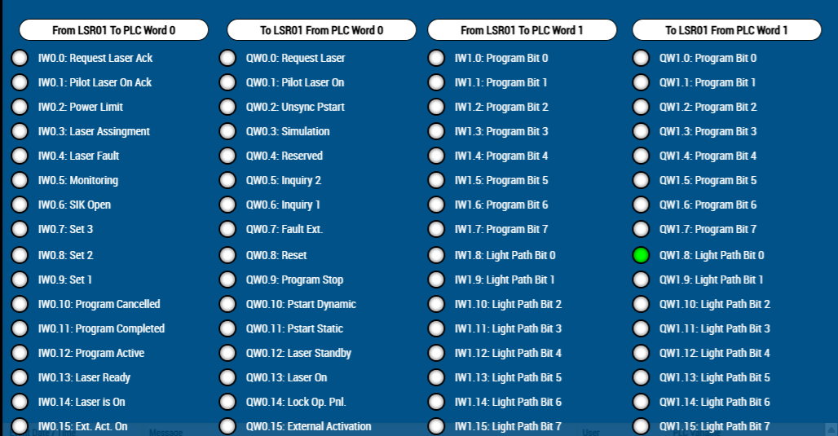
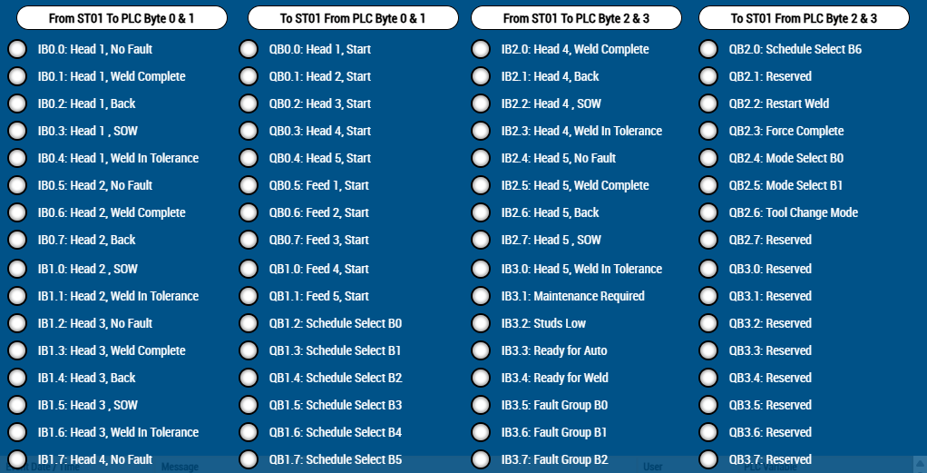
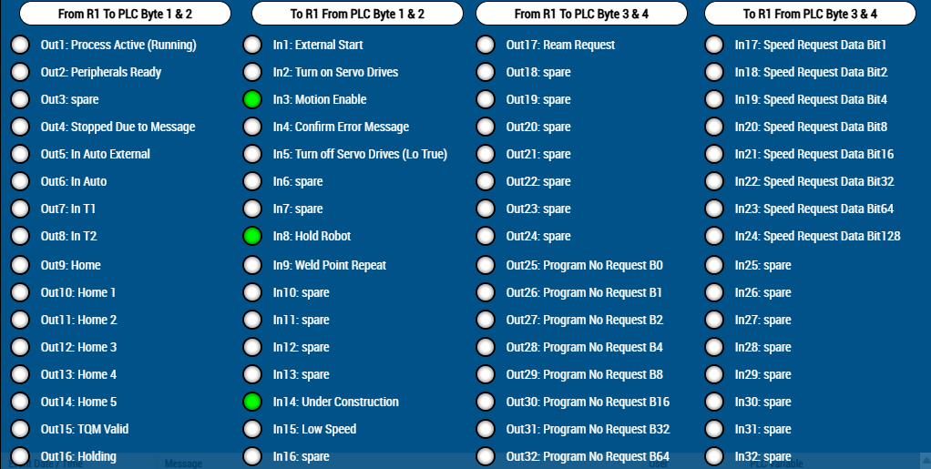
UI Database

Slide 16
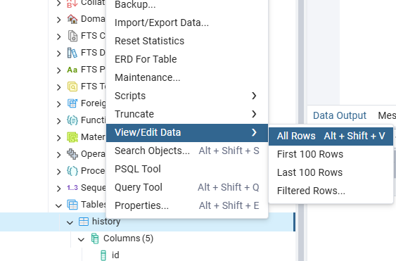
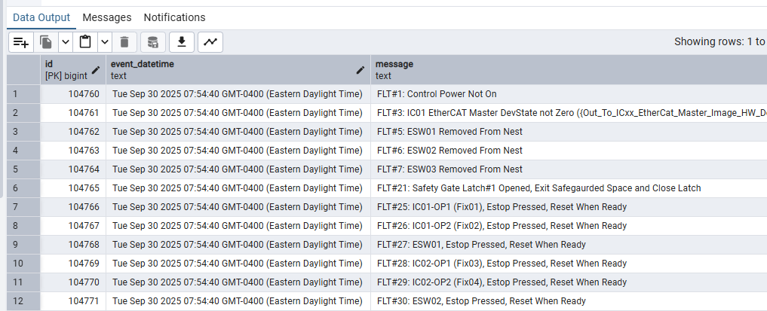
Navigating pgAdmin
View Table Data
If you want to view the data in any of the tables of any of the Databases, you can do so by this method:
Right click the table of interest, click View / Edit Data then click All Rows.
The data contained in the table will be displayed.

Slide 17
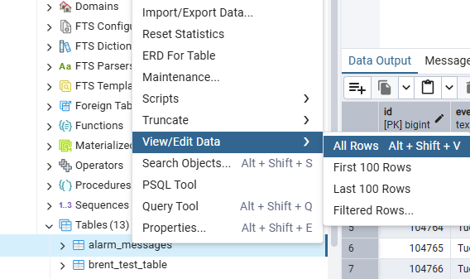
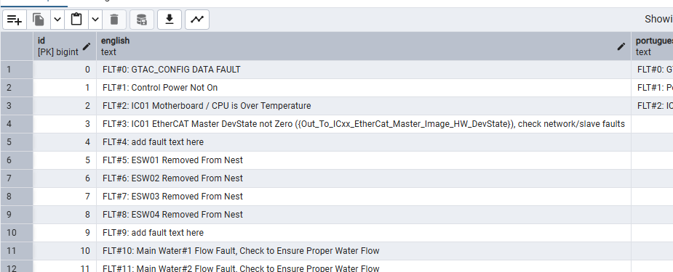
Navigating pgAdmin
Edit Table Data
If you want to edit the data in any of the tables of any of the Databases, you can do so by this method:
Note: Be careful editing!!
Right click the table of interest, click View / Edit Data then click All Rows.
The data contained in the table will be displayed. Onto the next slide!

Slide 18
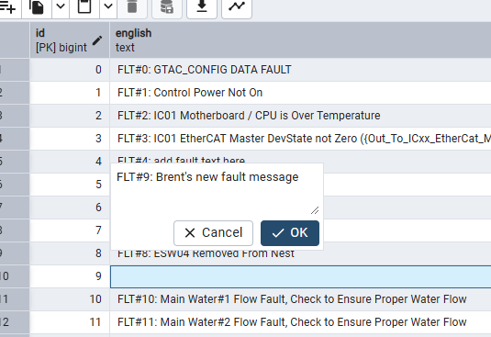
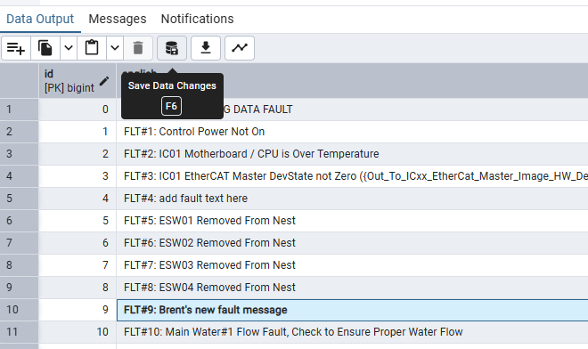
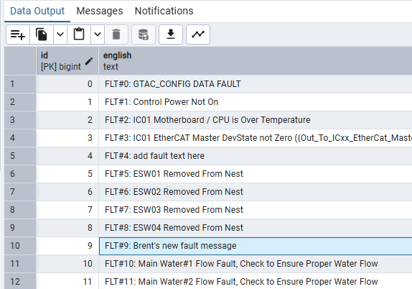
Navigating pgAdmin
Edit Table Data
If you want to edit the data in any of the tables of any of the Databases, you can do so by this method:
Note: Be careful editing!!
When you are happy with the edit, finalize it by clicking the Save Data Changes Icon, you will see the edited data change from bold back to standard font.
Double click the data record you want to edit, edit as required then hit OK.

Slide 19
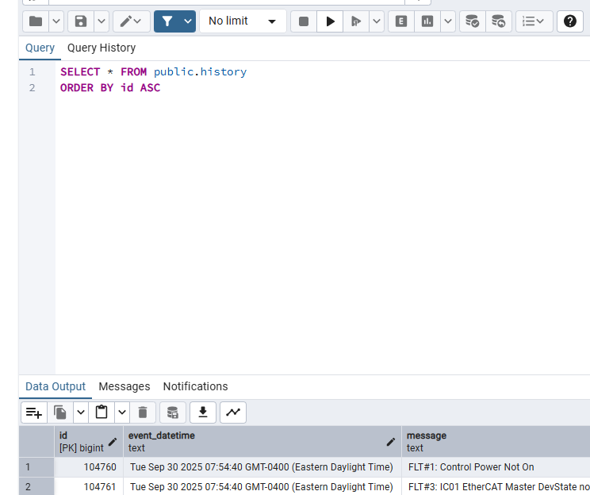
Navigating pgAdmin
Using SQL
While trialing the view and edit data methods in the past few slides, you may have noticed what pgAdmin is actually doing is sending SQL (Structured Query Language) statement (or queries) to the database server, the data output we saw was the response from the server. Below is an example of the SQL generated when we viewed some table data in previous slides.
Selecting the View / Edit Data and then All Rows is actually generating an SQL statement.
This is the SQL that was actually sent to the database server.

Slide 20
Navigating pgAdmin
Using SQL
Let’s breakdown what this query is asking from the DB Server:
SELECT * FROM public.history:
This is asking for all (*) data from the public table called history.
ORDER BY id ASC:
This sorts the data that will be returned in Ascending (ASC) order, based on the record id values.

Slide 21
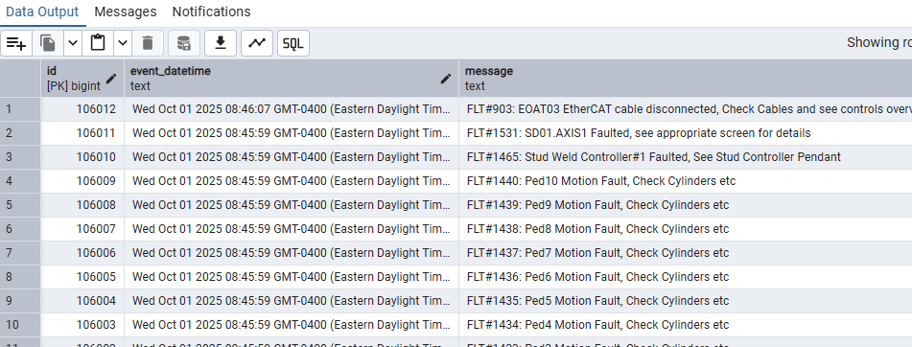
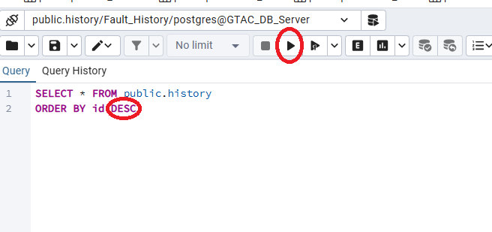
Navigating pgAdmin
Using SQL
We are free to generate our own SQL to interact with the DB server, let’s try!
For this first trial, we have changed the Ascending (ASC) keyword to the Descending (DESC) keyword, when we’re ready to execute, simply hit the Execute Script button.
The data records are now displayed to us in Descending order (newest to oldest) whereas when we used the ASC keyword, we saw the opposite.
DESC
ASC

Slide 22
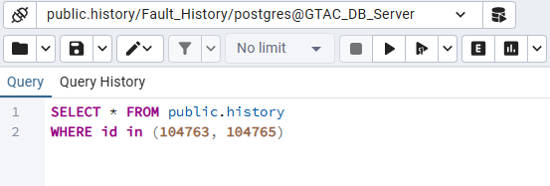
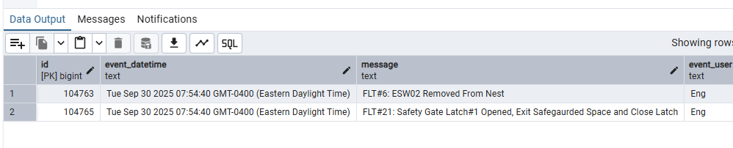
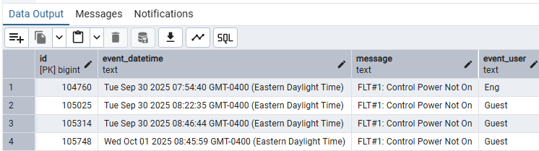
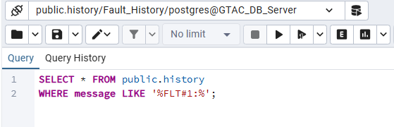
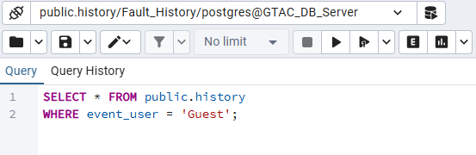
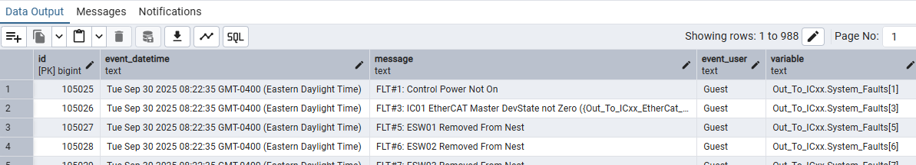
Navigating pgAdmin
Using SQL
Now let’s get adventurous and try a few different Queries.

Slide 23
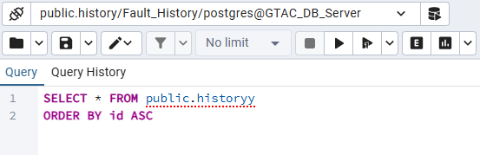
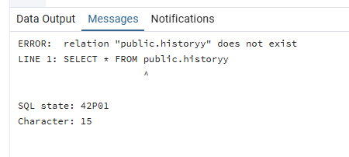
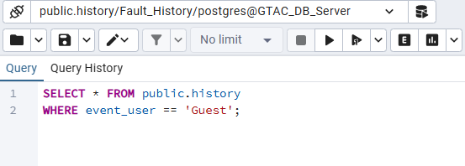
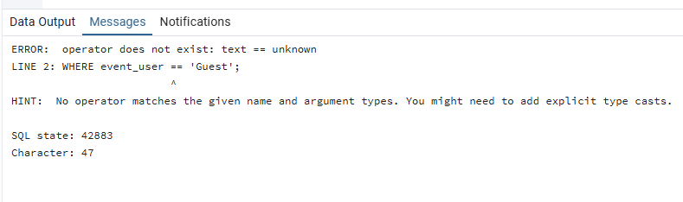
Navigating pgAdmin
Using SQL
SQL is very good at telling you when you have the syntax incorrect.

Slide 24
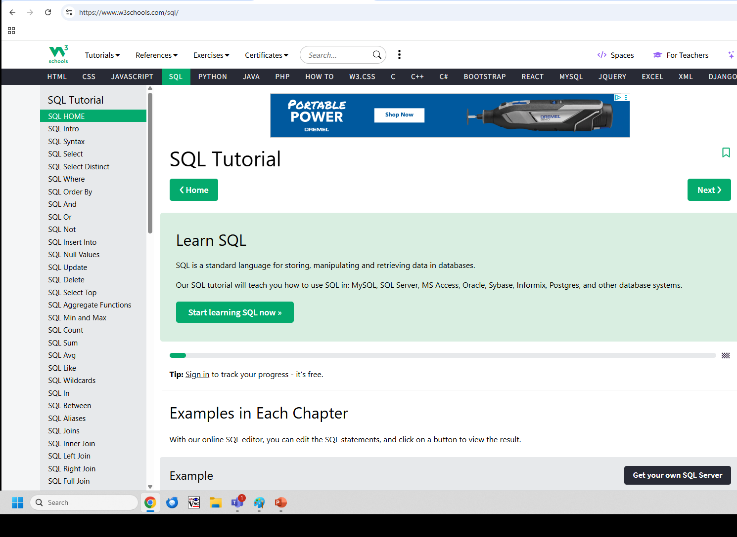
Navigating pgAdmin
Using SQL
The use of SQL queries in the last few slides may have you wondering what else can be done in SQL. The full use of SQL is well beyond the scope of this training session. SQL is a very powerful and commonly used language, well worth learning. Online resources can be used to further your understanding and skill set. One of my favorite resources is W3 schools.
https://www.w3schools.com/sql/

Slide 25

Q&A

Slide 26

Thanks for your time

